Slide 1
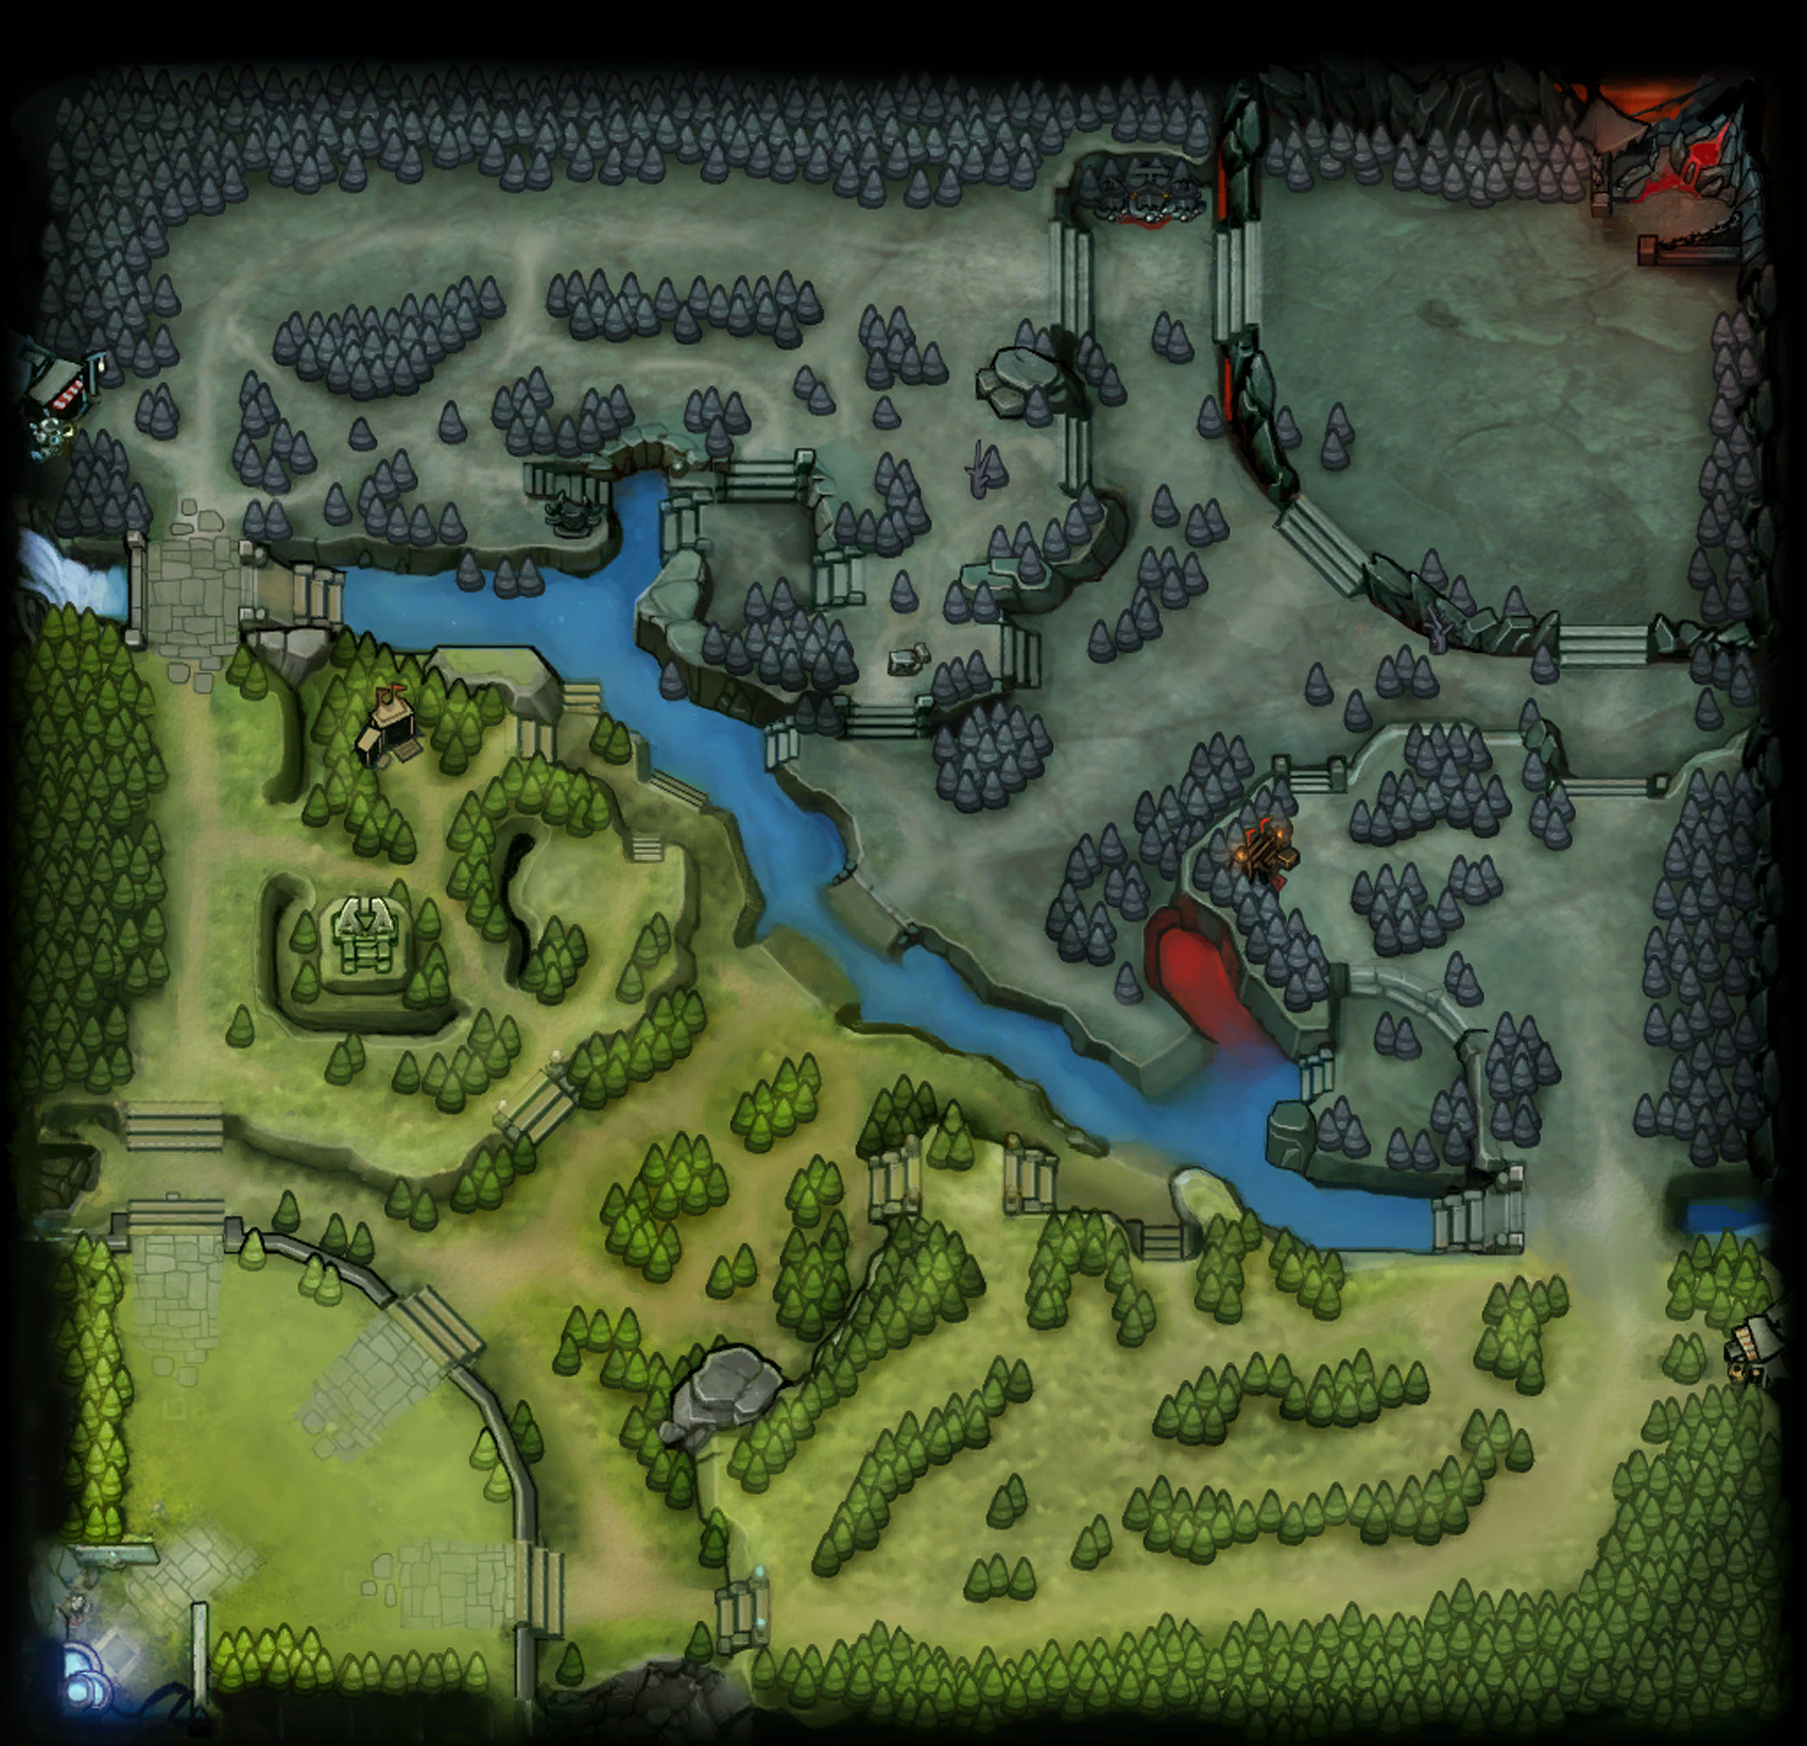
Angela Fan
Dire Ancient
Radiant Ancient

Slide 2
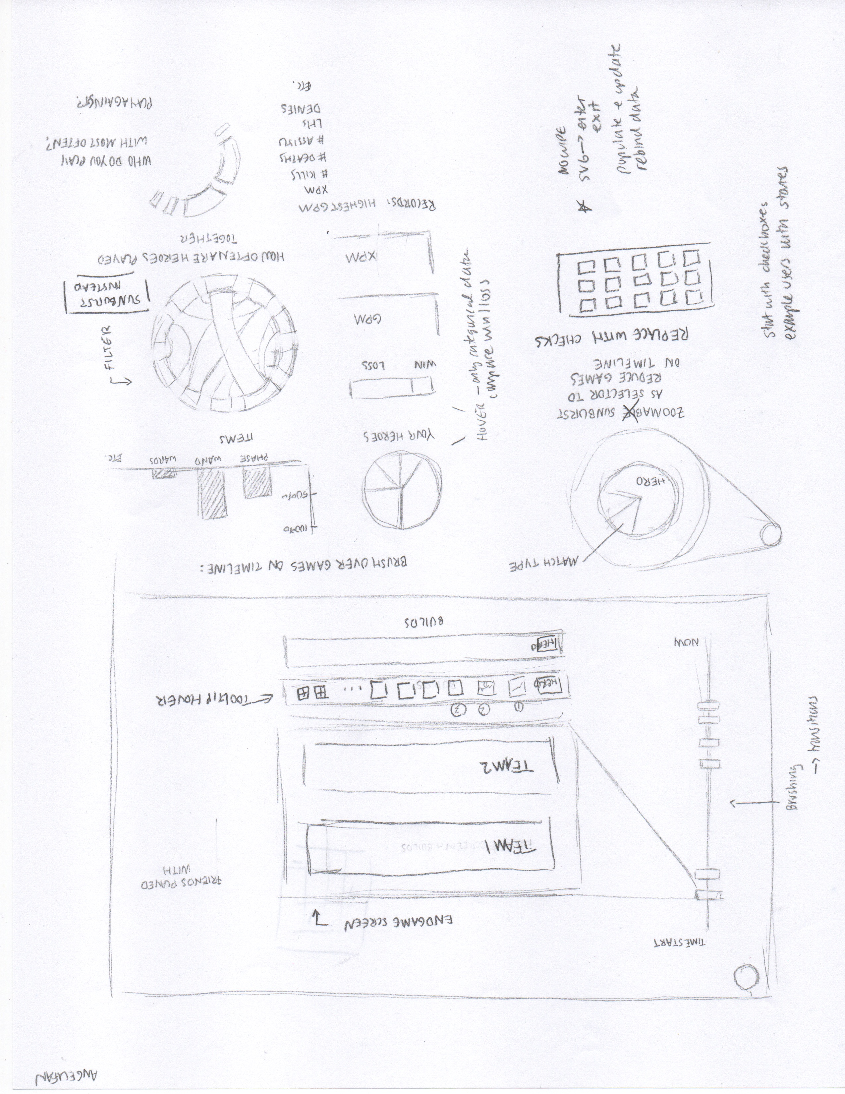
Overview Sketch, submitted with Project Proposal
Angela Fan
Main features:
Timeline down the left side of the page, displaying each user’s games. Has a brush feature so users can zoom in to a certain time period.
Has a selector in the upper left hand corner so users can filter down their selection by hero.
Main screen has a re-creation of the Dota2 endgame screen.
Contains a number of statistical data-driven graphs, such as a pie chart showing which heroes a user has played with, a chord diagram showing which heroes play together most often, and a bar chart displaying the items the user purchases most often.

Slide 3
Selector Design I
Angela Fan
Originally wanted a sunburst- people could filter by clicking on parts of the sunburst. This idea was not so good- if people wanted to filter across multiple categories, they would have to ascend and descend levels over and over again, and items would be difficult to find.
Simple dropdown with checkboxes- could be useful, but missing the pictures.
Images as selectors- this emulates the Dotabuff selector, as well as the setup of the Dota2 wiki. We chose to alphabetize within the Agility/Strength/Intelligence categories, as this would allow users to find heroes more rapidly (normal Dota2 order is the order in which heroes were added to the game, which is difficult to remember).
Most importantly, we don’t want the selector randomly hanging out all the time- we want the selector to only be brought up when necessary, so it should be a clickable button.
Users should be able to select all the heroes or subcategories of heroes without individually clicking each one, as that would be annoying.

Slide 4
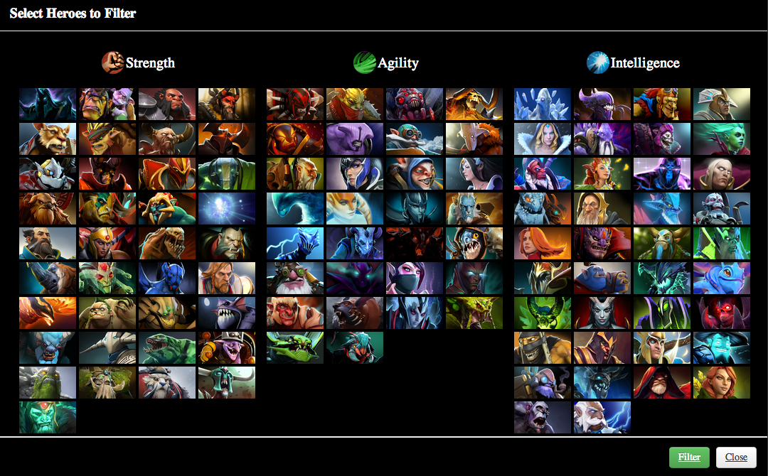
Selector Design II
Benjy Levin

Slide 5
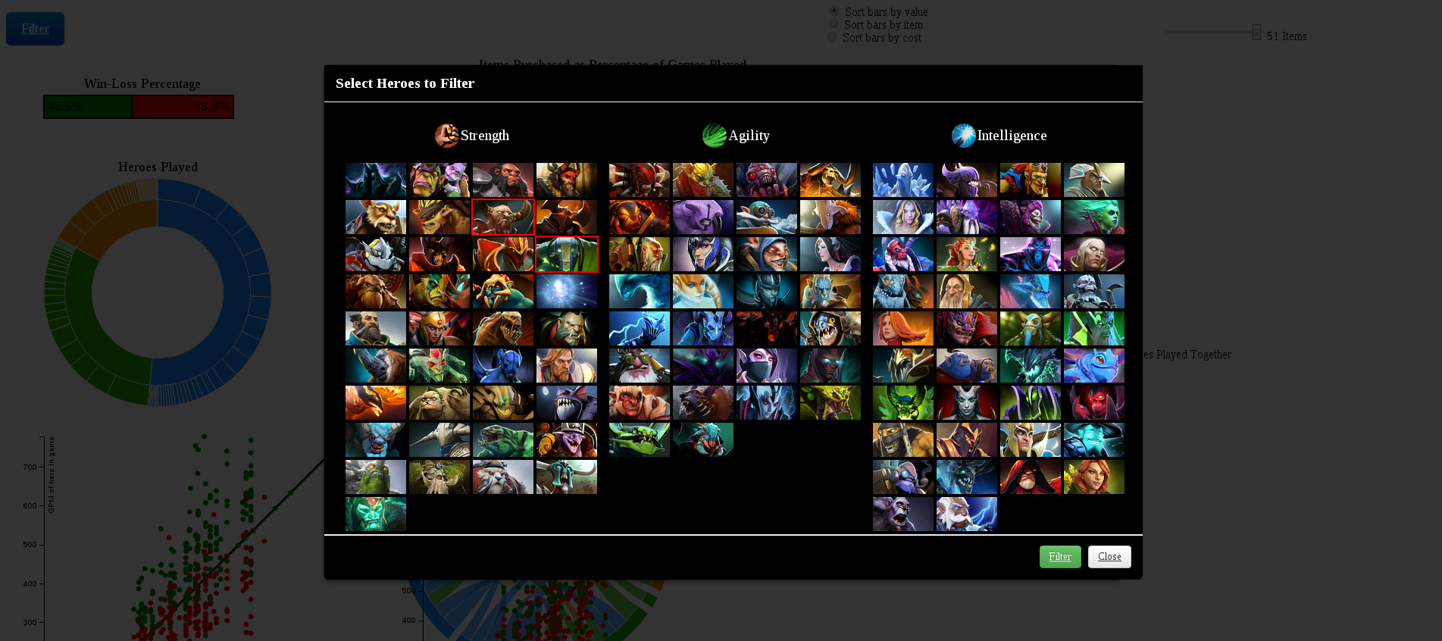
Selector Work III
Robbie Gibson

Slide 6
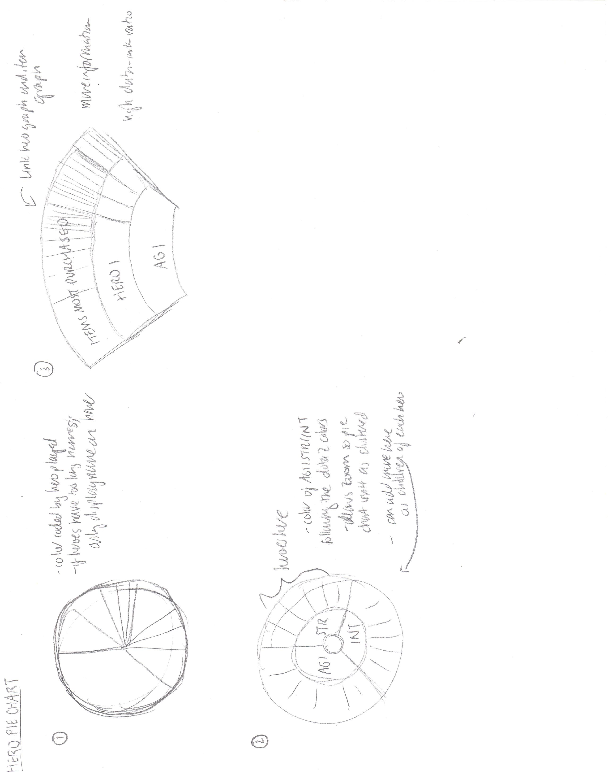
Designing the Statistical Graphs- the Hero Pie Chart I
Angela Fan
First Design- Simple Pie Chart
Pros:
Easy to understand
Cons:
A lot of tiny little slices that the user might not even be able to see, if we eliminate the pie won’t be 100% which is really bad
Overwhelming Graph with no interactivity
Second Design- D3 Sunburst Layout
Pros:
Zoomable so can keep a high data-ink ratio without overwhelming the user
Allows users to explore
We can add more information later by adding children to the sunburst layout, allowing more connection between graphs
Interactive + filterable

Slide 7
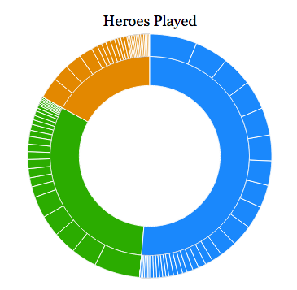
Designing the Statistical Graphs- the Hero Pie Chart II
April 5th Update
Angela Fan
Realization of the Sunburst Layout
To do:
1. Link this graph with items, possibly? More children.

Slide 8
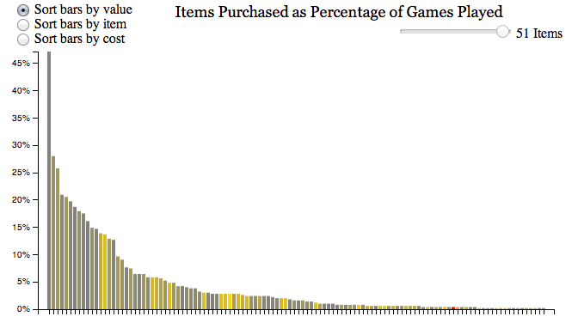
Designing the Statistical Graphs- the Items Bar Graph
Angela Fan
First Design- Bar Graph
Main worries:
The only other visual element of this graph is color, and here it is colored by cost. 1) not very intuitive and 2) not very useful- we already report the cost and allow sorting by cost. This coloring must be replaced.
2. NEEDS a color legend.
Features:
Slider bar filter so users can find top items
Sorting bars by value: this sorts by number of times the item was purchased- basically the main point of the graph
Sorting bars by item: this sorts alphabetically, so users can find the item they want- so if a user is more interested in one item, they can find that item
Sorting bars by cost: users may find this relevant, especially if they want to see how often they purchase a big expensive item
Tooltip for item, item picture, cost, and number of times purchased

Slide 9
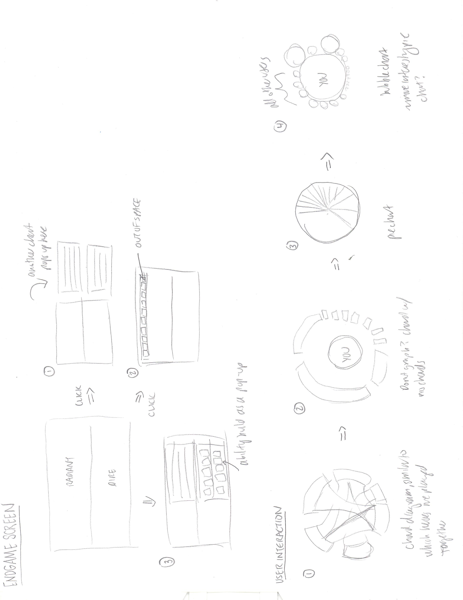
Designing the Statistical Graphs- the User Interaction Graph, Part I
Angela Fan
Chord Diagram
Pros:
Looks pretty cool, makes sense intuitively
Cons:
1. We don’t have the data for that many users, so we can’t represent interactions between other users. There aren’t that many chords!
No chords Chord Diagram
Pros:
Makes sense. Chord diagram without chords.
Cons:
1. Chord diagram without chords == bar chart?
Pie Chart
Pros:
Most sense! Intuitive!
Cons:
1. Users who I’ve only played one game with aren’t very interesting, but if we filter, the pie chart no longer represents 100% anymore

Slide 10
Designing the Statistical Graphs- the User Interaction Graph, Part II
Angela Fan
Bubble Chart
Pros:
More interesting visually than pie chart
Can filter it so it doesn’t necessarily need to represent 100%, but can display only users that you’ve played more than one or two games with
Cons:
Not as intuitively understandable as a pie chart
The central bubble that represents “you” is very very large compared to the other bubbles

Slide 11
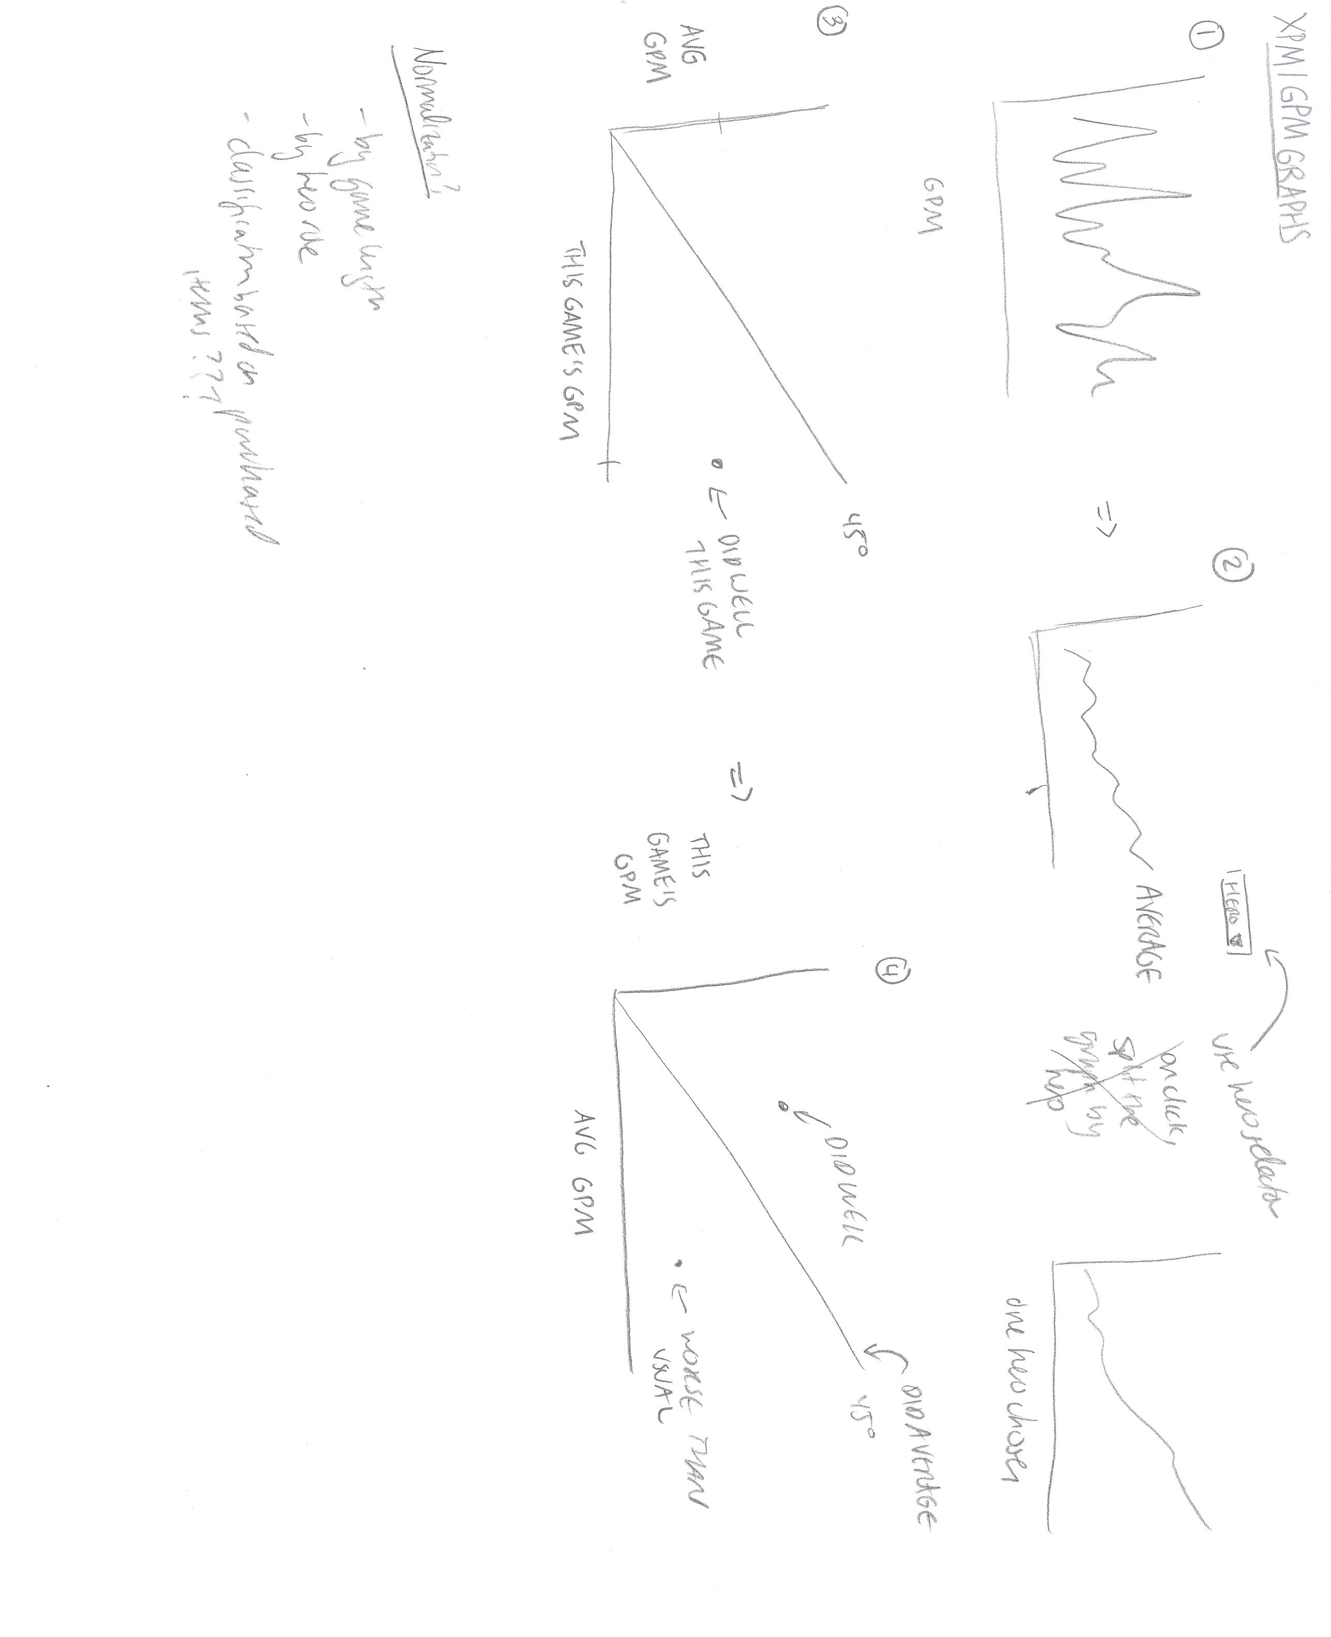
Designing the Statistical Graphs- the GPM/XPM Graphs I
Angela Fan
Line Graph
Time on X-axis, GPM on Y-axis
Pros:
Basic
Cons:
Not good measure- no normalization
No good comparative ability
Terrible way to detect trends
Line Graph II
Time on X-axis, GPM on Y-axis, but only the user’s average is plotted. There is a dropdown menu at the top of the graph, so user can pick to change which hero is plotted
Pros:
Can now try and detect hero-based trends
Cons:
Not good measure- still no normalization
No good comparative ability between heroes
Introduces yet another selector that overcomplicates the whole graph system

Slide 12
Designing the Statistical Graphs- the GPM/XPM Graphs II
Angela Fan
Scatterplot I
Average GPM for that hero on the x-axis, GPM for that game on that hero on the x-axis
Pros:
Comparative! Not between heroes but at least between games
Cons:
Not intuitive, since below the line is a “good game”
Still no normalization, and not comparative between heroes
Scatterplot II
Average GPM for that hero on the y-axis, GPM for that game on that hero on the x-axis
Pros:
Comparative! Not between heroes but at least between games
Intuitive, since being above the line is great game and being below the line is a bad game
Cons:
Still no normalization, and not comparative between heroes

Slide 13
Designing the Statistical Graphs- the GPM/XPM Graphs III, April 5 Update
Angela Fan
Normalization Needs
Over game length- in a longer game, heroes on average get much stronger than in a shorter game
Data bias- sometimes the game ends accidentally before it actually begins- these GPM/XPM values are skewing the mean
Based on hero role- if you play different roles, sometimes you have different GPM/XPM. If a hero can fit multiple roles (carry/support, like Alchemist), then the mean isn’t a good representation of an average game of either role. For example, if you play carry Alch 50% of the time and support Alch 50% of the time, the mean GPM floats between the two, but that doesn’t mean that your support Alch games are “worse” games on average
This graph doesn’t help evaluate how heroes do with farm, or how fast a hero can farm, which are both interesting questions.
Future Development
A good question this graph could answer is “what happened in that game???” if the game is “worse” than average. We need to have an on click event, that brings up the end-game screen of the respective game.

Slide 14
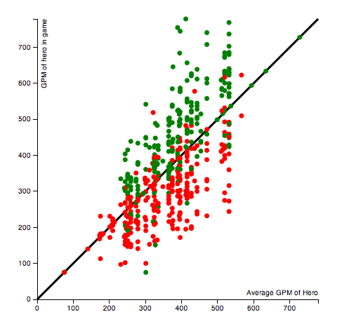
Designing the Statistical Graphs- the GPM/XPM Graphs IV, April 5 Update
Angela Fan
Looks pretty good.
Heroes are lined up in lines based on the x-axis, which are heroes that are played often.
Has a tooltip mouseover.
Need to have on-click event.

Slide 15
Designing the Endgame Screen I
Robbie Gibson
Sketches by Angela

Slide 16
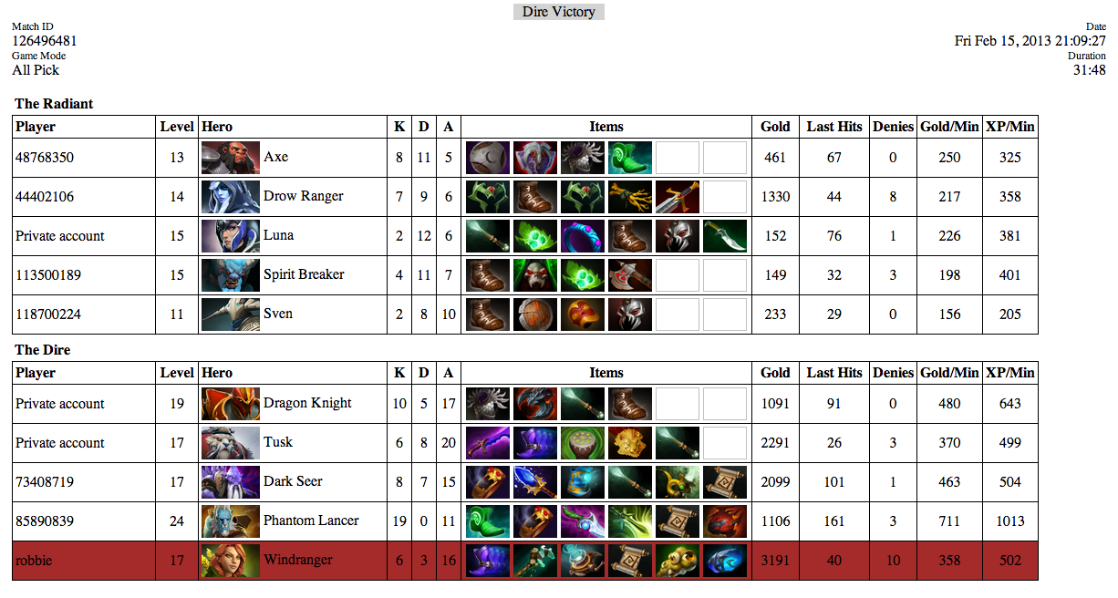
Designing the Endgame Screen I
Robbie Gibson

Slide 17
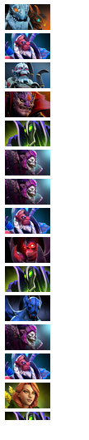
Designing the Timeline
Benjy Levin

